Slide 1
AIRBNB PRICE DETERMINANTs
Team MEMBERS
201627015 Melİsa YILDIZ ​
201611033 Selİn KARA
201514039 Merve KARAKAYA ​
201512019 Rana GÜrcü DELİÖMEROĞLU
Advisor
​Dr. Roya CHOUPANI ​

Slide 2
Contents
Problem
Objectives
Analysis
Solution
Conclusion
Future Works
References

Slide 3


Problem…
Airbnb is a worldwide house and property rental platform that provides short-term accommodation services to those who prefer houses to hotels.
Airbnb is getting more popular day by day.

Slide 4

Problem
In recent years, people prefer to use platforms such as Airbnb, which determine the price according to the characteristics of the place they will stay, instead of fixed and generally high-priced hotels during their touristic trips and holidays.
Although hosts can compare prices manually with other houses and they can determine a price for their house but this is not a healthy method.

Slide 5

OBJECTIVES
Airbnb is different from other types of accommodation due to its structure. This is why Airbnb pricing strategy requires different approaches.
Different methods are used in this pricing strategy. This situation differs from country to country, from city to city, and even in regions within the same city.
There are many factors for pricing policy.

Slide 6
AnalysIs
We examined similar studies conducted in 2017 to 2020 for our Airbnb price determinant project.
It has been observed that regression and classification is the most effective method in projects in the area of price determinants and sharing economy.
Logistic Regression, KNN, Naive Bayes, Random Forest and Decision Tree algorithms were examined.

Slide 7
SOLUTION...
A pricing platform is offered as a solution proposal to the specified problem for hosts.
That is, the platform we will create to Airbnb for the price determination policy will be a web application.

Slide 8
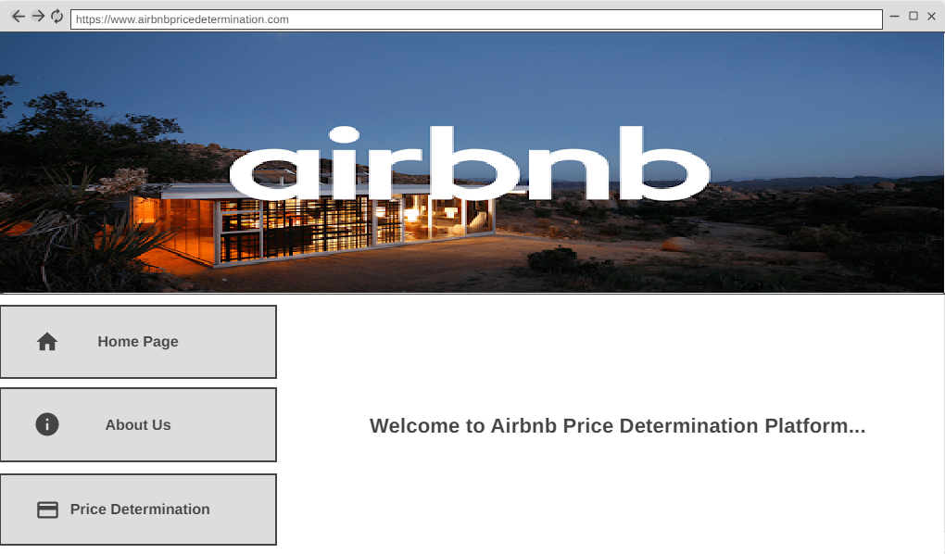

Slide 9
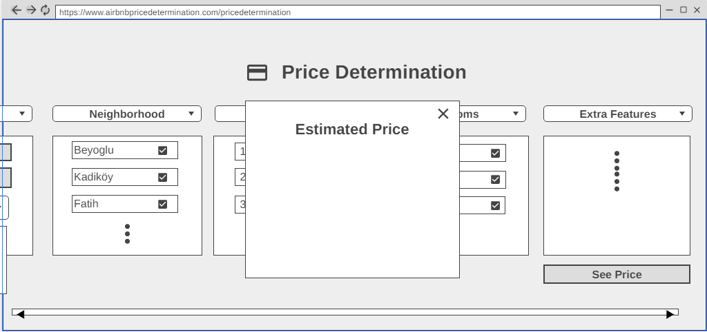
PrICE DETERMINATION

Slide 10
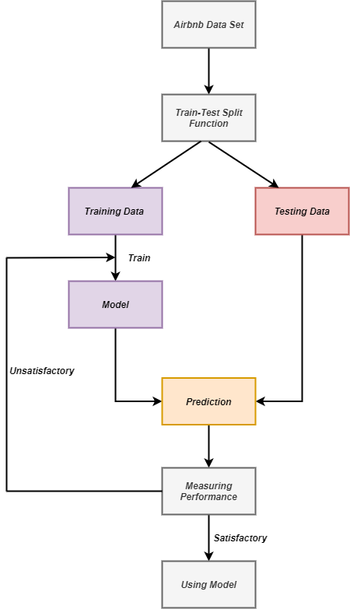
MODEL & METHODOLOGIES
The system flow diagram of the machine learning model that will work for price determination on this platform.

Slide 11
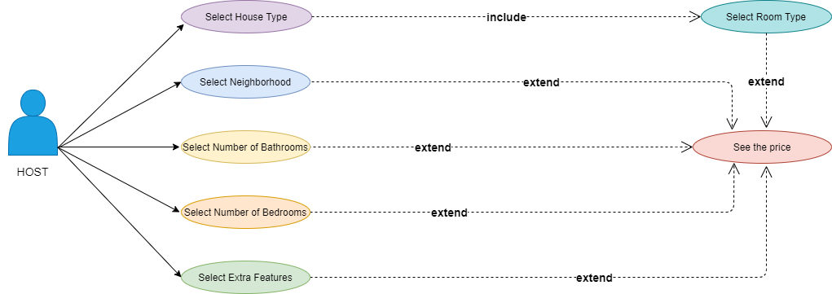
Use cases of the PLATFORM

Slide 12


Technology Used
Python (Pandas, SkLearn, Keras,TensorFlow etc.)
ASP .NET
MSSQL

Slide 13
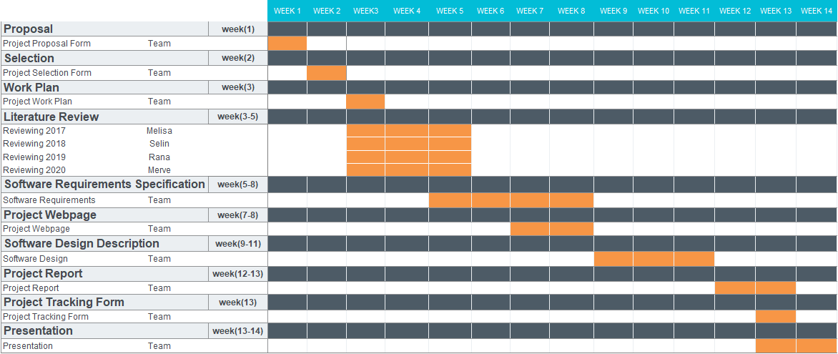
Project Work Plan

Slide 14

FUTURE WORKS
Model Training
Model Testing
Implementation

Slide 15
ConclusIon
As a result of this project, an analysis of past studies was carried out to create a price setting system.
Researches on Machine learning and Deep learning algorithms that can work in harmony with the project were carried out, and the studies of classification and regression models were also examined.

Slide 16
References
https://www.airbnb.com
http://insideairbnb.com/get-the-data.html
Malay Haldar, Mustafa Abdool, Prashant Ramanathan, Tao Xu, Shulin Yang, Huizhong Duan, Qing Zhang, Nick Barrow-Williams, Bradley C. Turnbull, Brendan M. Collins and Thomas Legrand, Applying Deep Learning To Airbnb Search, August 2019.
V. Raul Perez-Sanchez , Leticia Serrano-Estrada , Pablo Marti , Raul-Tomas Mora-Garcia. The What, Where, and Why of Airbnb Price Determinants, December 2018.

Slide 17

THANK YOU!

